Slide 1
Programming Made Easy
Bartek Wasielak

Slide 2




About me
Bartek Wasielak
@bwasielak

Slide 3
Infusion is hiring
.NET Consultants
One year of experience or senior
Front-end developer (HTML/CSS)
+XAML +jQuery
Graphic designer (Ps, Ai, mobile)
QA Analyst/Tester (Junior/Senior)
infusion.com/
careers

Slide 4
Agenda
Programming in general
Different techs and languages
Programming for the Web
Introduction to OOP
Hands On Lab

Slide 5
Programming in general

Slide 6
What can we achieve?
Build application no-one’s built
Modify existing app’s behaviour
Consume any data
Make your life easier
Fun!
Notes:
An application for my wife for time tracking – there was no simple free time tracking app

Slide 7
Different kind of applications
Desktop applications
Web applications
Mobile applications
Embedded applications
Notes:
Desktop apps are usually specific for a particular platform (operating system). Sometimes they can be OS agnostic. Usually not so robust as native ones.
Explain what native means.
Web application – works on a server side, presented to a user by a browser. Usually OS and browser agnostic. Sometimes use technology that requires specific OS/browser. Example: Flash doesn’t work on iOS. Silverlight has no official and current implementation for Linux (works on Windows and Mac only)
Embedded applications – robotic rovers, washing machines, home a

Slide 8
Technologies and languages

Slide 9
What does a computer do?
Computer programs are text documents
Programs are executed by a processor (CPU)
CPU doesn’t execute text

Slide 10
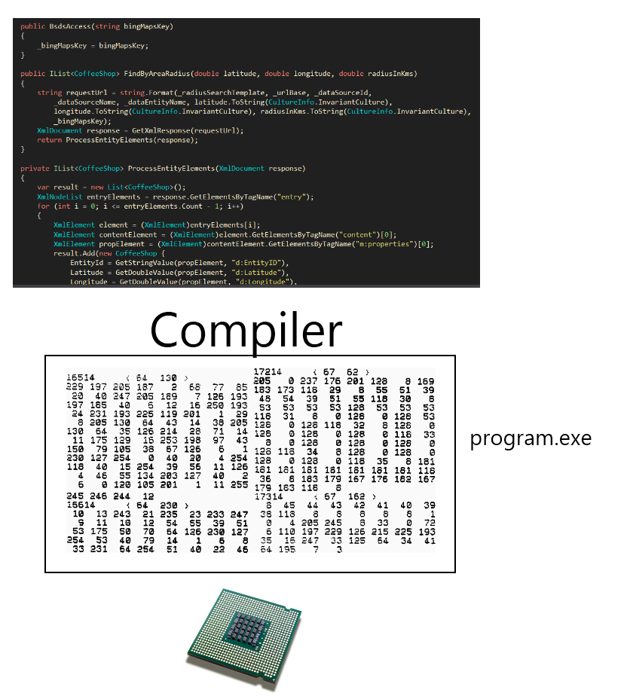
Compiling

Slide 11
Compiling
Maximum robustness
Need to compile against every CPU

Slide 12
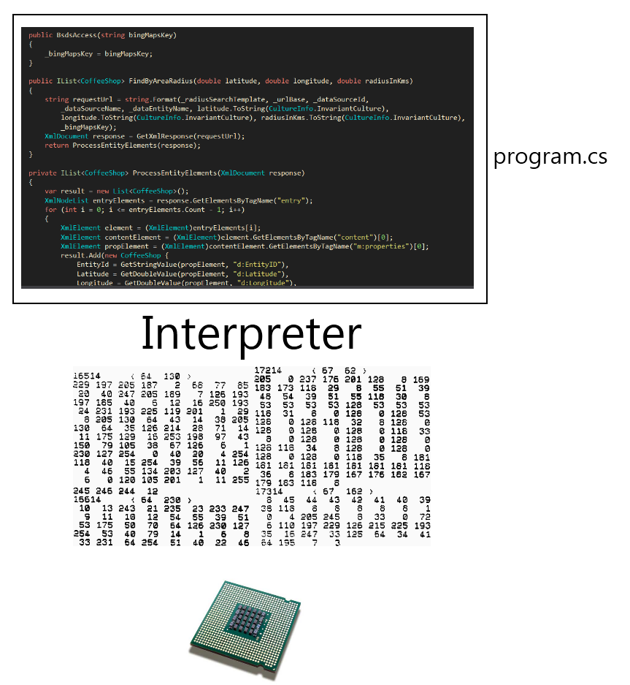
Interpretation

Slide 13
Interpretation
Poor efficiency
Need to have an interpreter for every OS/CPU
Everyone can see the code
No need to recompile
Notes:
Often used in the Web

Slide 14
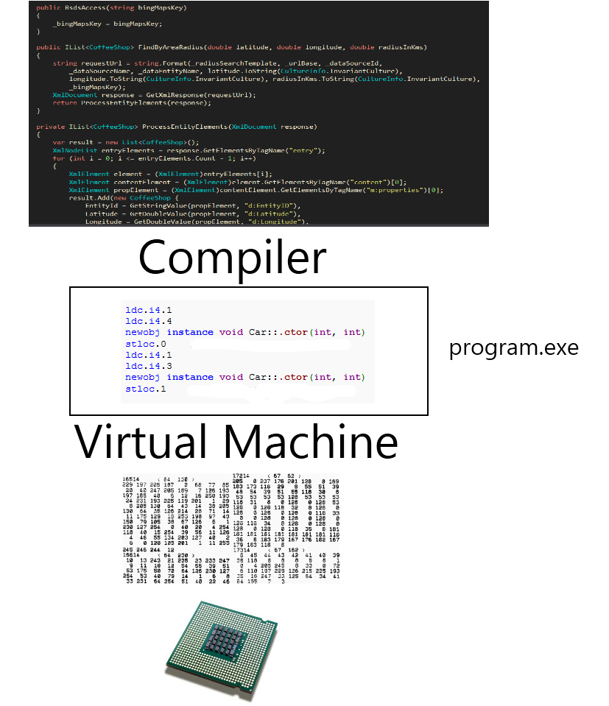
Virtual machine

Slide 15
Virtual machine
Medium efficiency
Compile once – to bytecode
Need to have a VM for every OS/CPU

Slide 16
The web - Web request
User types an address in a browser
The browser contacts a right server
The server recognizes the request
The server finds a program bound to the address
The program executes and returns an HTML document
The browser downloads the document
The browser executes all the code attached to the documents
Notes:
Describe what server is

Slide 17
Object Oriented Programming
Programming paradigm
Using objects
Each object is an instance of a class
Each class has fields and methods
Notes:
Objects – encapsulate state and expose behaviour

Slide 18


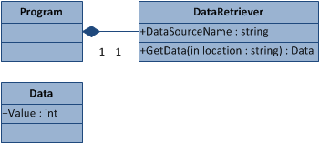
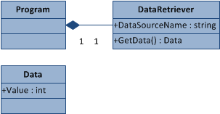
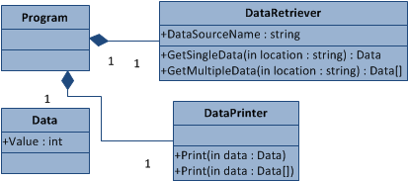
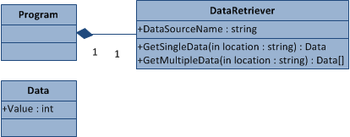
Object Oriented Programming

Slide 19
Let’s get our hands dirty!

Slide 20
Establish a project
Login to coderun.com
Open http://bit.ly/webMusesCR
Right-click solution name (in red)
Choose Add to my projects
Build
Run
Notes:
webmusespresenter

Slide 21



Architecture

Slide 22
Task 0 – change a header
Open HomeController
Change text in Index method
Build
Run (or refresh)
Verify

Slide 23
Task 0.1 – prepare a text control
Open Index.aspx
<%= ViewData["Text"] %>
Open HomeController
Find Index method
Assign some text to ViewData["Text"]

Slide 24
Task 0.3 – prepare a text control cont’d
Surround
<%= ViewData["Text"] %>
with a <div> with an id
Add inline style
Add a border

Slide 25
Task 0.4 – Import API
Open Global.asax.cs
Change {controller} to {controller}.aspx
Right click on Controllers
Add→New Item..., then Class
Paste a snippet from https://raw.github.com/
bartekwasielak/Presentation/master/snippet.txt
Run using /Home.aspx

Slide 26
Task 1.0 – On MVC
MVC is a pattern and solution template
Separates different parts of the code
All actions – classes in Controllers
All pages – views in Views
Does all the scaffolding
We will use HomeController.cs only

Slide 27
Task 1.1 – Using variables
Each instruction ends with a semicolon;
Variable
VarType varName;
Text → string
Number (23) → int
Number (2.34) → double

Slide 28
Task 1.2 – Accessing properties
Get property’s value:
varName.Property
Set property’s value:
varName.Property = ...;

Slide 29
Task 1.3 – Calling a method
varName.Method();
varName.Method(param);
string result = varName.Method();
ObjectType varName = new ObjectType();

Slide 30
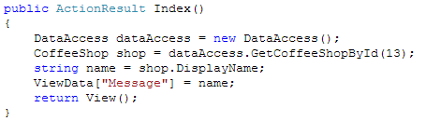
Task 1.4 – Display a record
Modify Index method
Create a new instance of DataAccess
Call GetCoffeeShopById(...) on it
Assign the result to a variable of type CoffeeShop
Assign its value DisplayName to a string variable
Assign this variable to ViewData[„Message”]

Slide 31
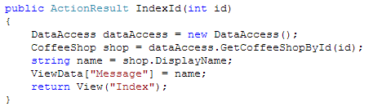
Task 2 – Display a record of a given id
Move to IndexId method
It has a parameter!
A parameter of type int
Copy the body of Index method
But use a parameter
Run Home.aspx/IndexId/17

Slide 32
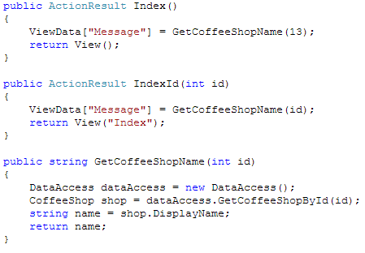
Task 2.1 – Extract a method
First refactoring!
Create new method
Add a parameter of type int
Copy three common lines
Add a return statement
Use your new method!

Slide 33
Task 3.0 – Operations on variables
int v = 2 + 4;
int p = v + 3;
p = p + 2;
string a = „ach!”;
a = a + „To Ty!”;

Slide 34
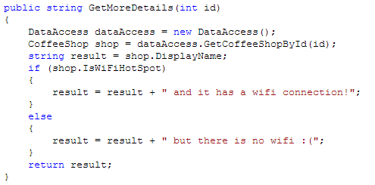

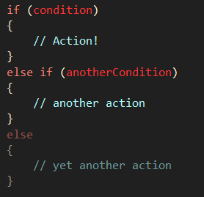
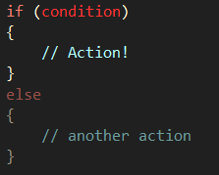
Task 3.1 – displaying more data
Move to IndexWifi method
Write another helper method
(Call it GetMoreDetails maybe?)
Check if there is a wifi connection
(IsWiFiHotSpot property)
Notes:
15 no wifi
16 wifi

Slide 35
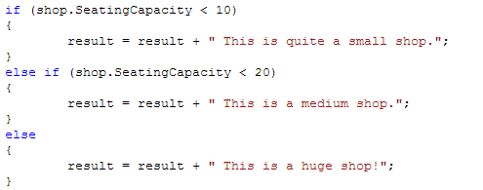
Task 3.1 – add more conditions!
Check SeatingCapacity
Small (<10), medium (10-20), big (>20)
Notes:
#10 big (20)

Slide 36

Task 3.2 – Join conditions
Looking for a big shop accepting coffee cards
(AcceptsCoffeeCards property)
&& - means AND
|| - means OR
Try other conditions
For string
PrimaryCity == „Miami”
Notes:
10003 – 25, true
10129 – 25, false
15 – Miami
250 – Weston

Slide 37
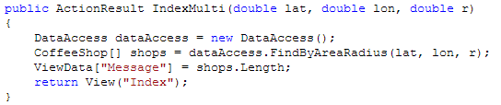
Task 4 – Read multiple records
Move to IndexMulti method
Use FindAreaByRadius method on DataAccess
As a result you get an array
Use array’s proprerty Length
Call it with .../IndexMulti/?lat=...
&lon=...&r=...
Use φ=40.75, λ=-74, r=1

Slide 38
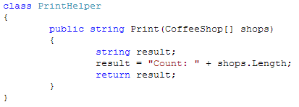
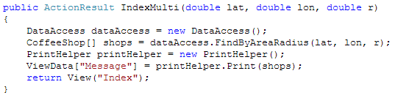
Task 4.2 – Prepare to print all the records
Add a new folder: Helpers
Create a new class: PrinterHelper
Create a method Print
It should accept CoffeeShop[]
and return string
Move counting logic there

Slide 39

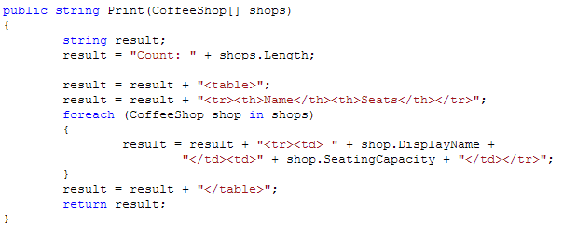
Task 4.3 – Print all the records
Iterate through the shops
Foreach – goes through every member of a collection
Construct HTML table
Use <table>, <tr>, <th> and <td>

Slide 40
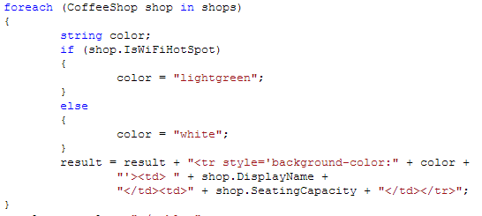
Task 4.4 – Add conditional formatting
Check if wifi is available
Set background colour for rows

Slide 41
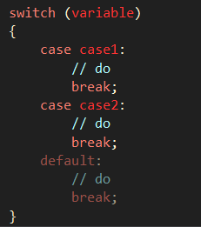
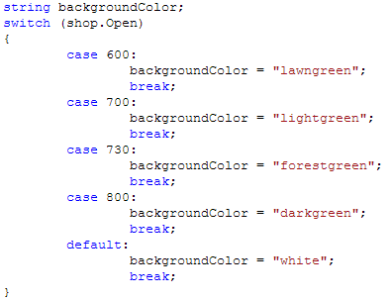
Task 4.5 – More conditional formatting – switch
Set colour based on shop’s opening time
Switch replaces multiple if’s with condition on the same variable

Slide 42

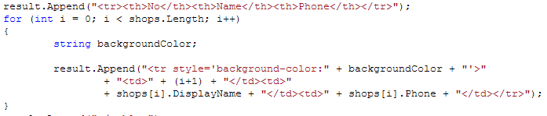
Task 5 – Play with collections
Display shop’s # on the page
Need to use for instead of foreach

Slide 43
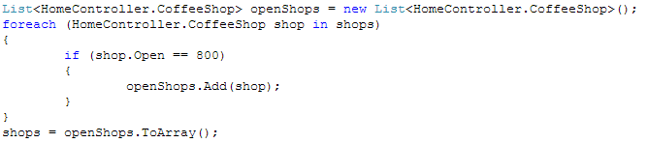

Task 5.1 – Display only some shops
Display shops opening at 8am only
Need to pass a smaller collection
Modify IndexMulti method
Create new collection
Put only suitable elements
Print new collection

